Slide 1


FY B.Tech Trimester 2 2021-22
PBL Activity
Basic Arduino Calculator
Course: BEEE (ECE1022A)
BY
Shreerang Mhatre
FY Division: 11, Batch: K3
(1032211745)
(111056)

Slide 2

Outline
Introduction
Project Description (Block Diagram)
Explanation with circuit diagram
Simulation Results Screenshots
Applications
Conclusion and learning experience
References

Slide 3
Introduction
Calculator:
A calculator is a device that performs arithmetic operations on numbers. The simplest calculators can do only addition, subtraction, multiplication, and division. More sophisticated calculators can handle exponential operations, roots, logarithm s, trigonometric functions, and hyperbolic functions. Internally, some calculators actually perform all of these functions by repeated processes of addition.
Arduino:
Arduino is an open-source platform used for building electronics projects. Arduino consists of both a physical programmable circuit board (often referred to as a microcontroller) and a piece of software, or IDE (Integrated Development Environment) that runs on your computer, used to write and upload computer code to the physical board.

Slide 4
Basic Arduino Calculator
Nowadays Calculators plays a vital role everywhere. Even for a small calculations we seek for it. So here is a simple Calculator designed using Tinkercad Software. Here in this project is the calculator takes input from a user in real-time via a keypad and displays output on a LCD display module, the control, arithmetic algorithm and calculation functions are performed using a Arduino UNO R3. The prototype of the system is configured and the simulation results for basic mathematical functions of calculator are expressed with the help of Tinkercad Software.

Slide 5
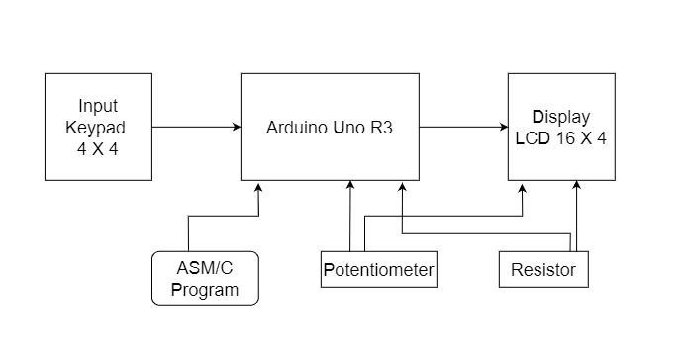
Block Diagram

Slide 6
Explanation
Arduino uno is used as microcontroller in the project. Arduino takes the input from user and after analyzing the instructions produces output. The output is than displayed on 16×2 lcd. 4×4 numeric keypad is used as input. User presses the buttons on keypad to give input to Arduino calculator. Arduino calculator takes two digits and an operator as input. Arduino calculator then identifies the operator, computes results according to the operator and then displays the result on 16×2 lcd screen.
Lcd 16×2 is interfaced in 4-bit mode with arduino uno. Arduino pins D13, D12, D11, D10, D9 and D8 are occupied by 16×2 lcd. 4×4 Keypad rows are connected to pins D4, D5, D6 & D7 of arduino uno. Columns of keypad are connected to pins D0, D1, D2 & D3 of arduino uno.
A Potentiometer is used to control the contrast of the LCD display. A Resistor of 1 K ohm is used to give appropriate current to the lcd display. Connecting wires are connected accordingly and breadboard is used for better connections of the circuit.
Liquid Crystal library (<LiquidCrystal.h>) contains predefined functions which could be used in arduino code to easily interface and operate 16×2 lcd with arduino uno. I am interfacing 16×2 lcd in 4-bit mode with arduino uno. A special library called (<keypad.h>) is used in order to find out which key is pressed.

Slide 7
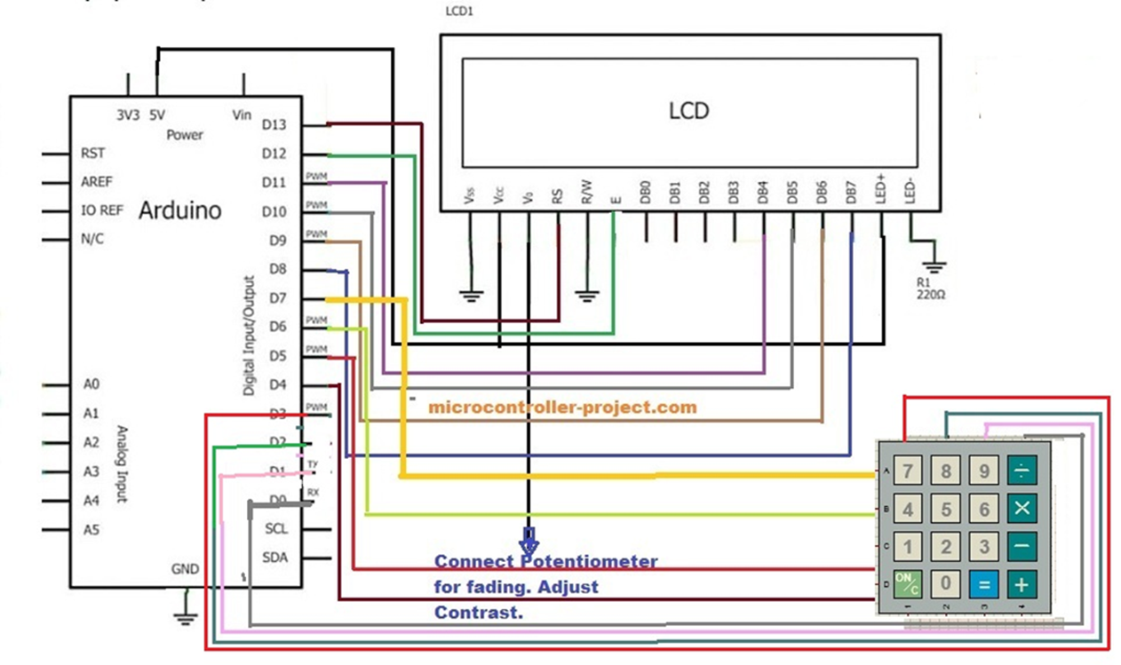
Circuit Diagram

Slide 8
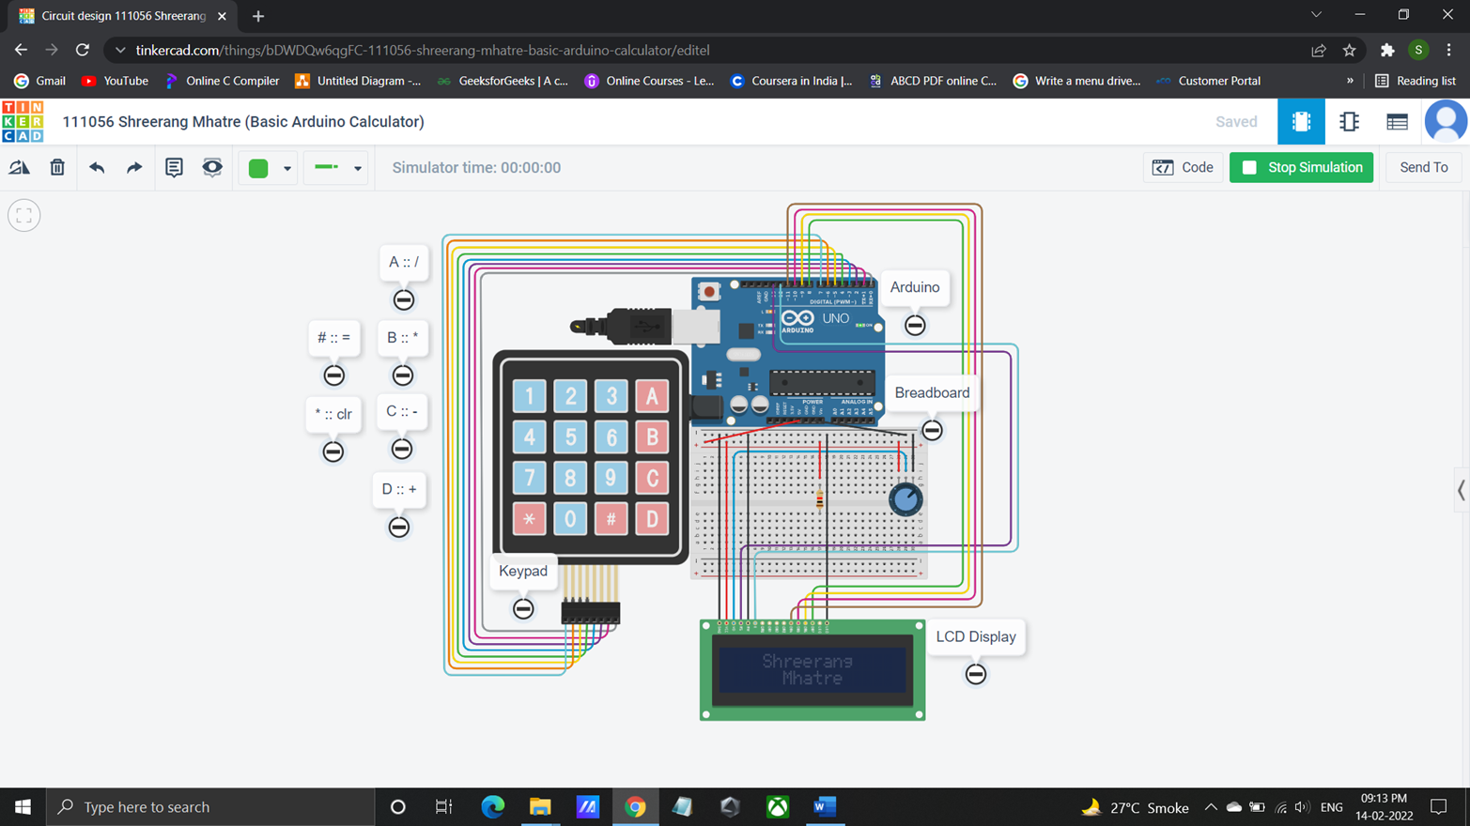
Basic Arduino Calculator on Tinkercad

Slide 9
Applications
A simple arithmetic calculator is implemented in this project using Arduino UNO, matrix keypad and LCD.
Can be extended to perform complex calculations, but the logic must be carefully designed in order to solve those calculations. This may even result in increased number of switches.
Used to perform daily mathematical calculations etc.
Getting Knowledge of how a calculator works and also knowing how to
make one using an online simulation platform like Tinkercad.

Slide 10
Conclusion
Although this project is a simple calculator made with an Arduino, it mainly explains how to use a keypad to acquire characters and form a whole number out of individually entered characters.
It also explains how to control an LCD connected to an Arduino and combine the two into a functional calculator.
This program is limited by the Arduino's platform variables and math, Arduino has limitations when it comes to big numbers and floating point. For example, when it comes to floating point numbers, you have float and double. Double should have bigger precision than float, but on Arduino that is not the case. So using double instead of float will not give higher precision unless you are using an Arduino Due.

Slide 11
Tinkercad link:
https://www.tinkercad.com/things/bDWDQw6qgFC-111056-shreerang-mhatre-basic-arduino-calculator/editel
References:
https://learn.sparkfun.com/tutorials/what-is-an-arduino/all
https://www.learnelectronicsindia.com/post/arduino-diy-calculator-using-a-4-4-keypad-and-16-2-lcd-display
https://www.engineersgarage.com/calculator-using-arduino/

Slide 12
Thankyou

